Slide 1
Astronomy Talk At Jenks
July 28, 2026
Richard Koolish

Slide 2

Who Am I?
Retired Computer Programmer
Lives in Arlington
Member of The Amateur Telescope Makers of Boston
Member of The Antique Telescope Society
Member of the North American Sundial Society
Caption

Slide 3
Astronomy Is The Study Of The Universe
Time: From the very beginning to the very end
Space: From here to the farthest that we can see

Slide 4
What Is The Universe Made Of?
Galaxies
Groups of galaxies
Clusters of galaxies

Slide 5
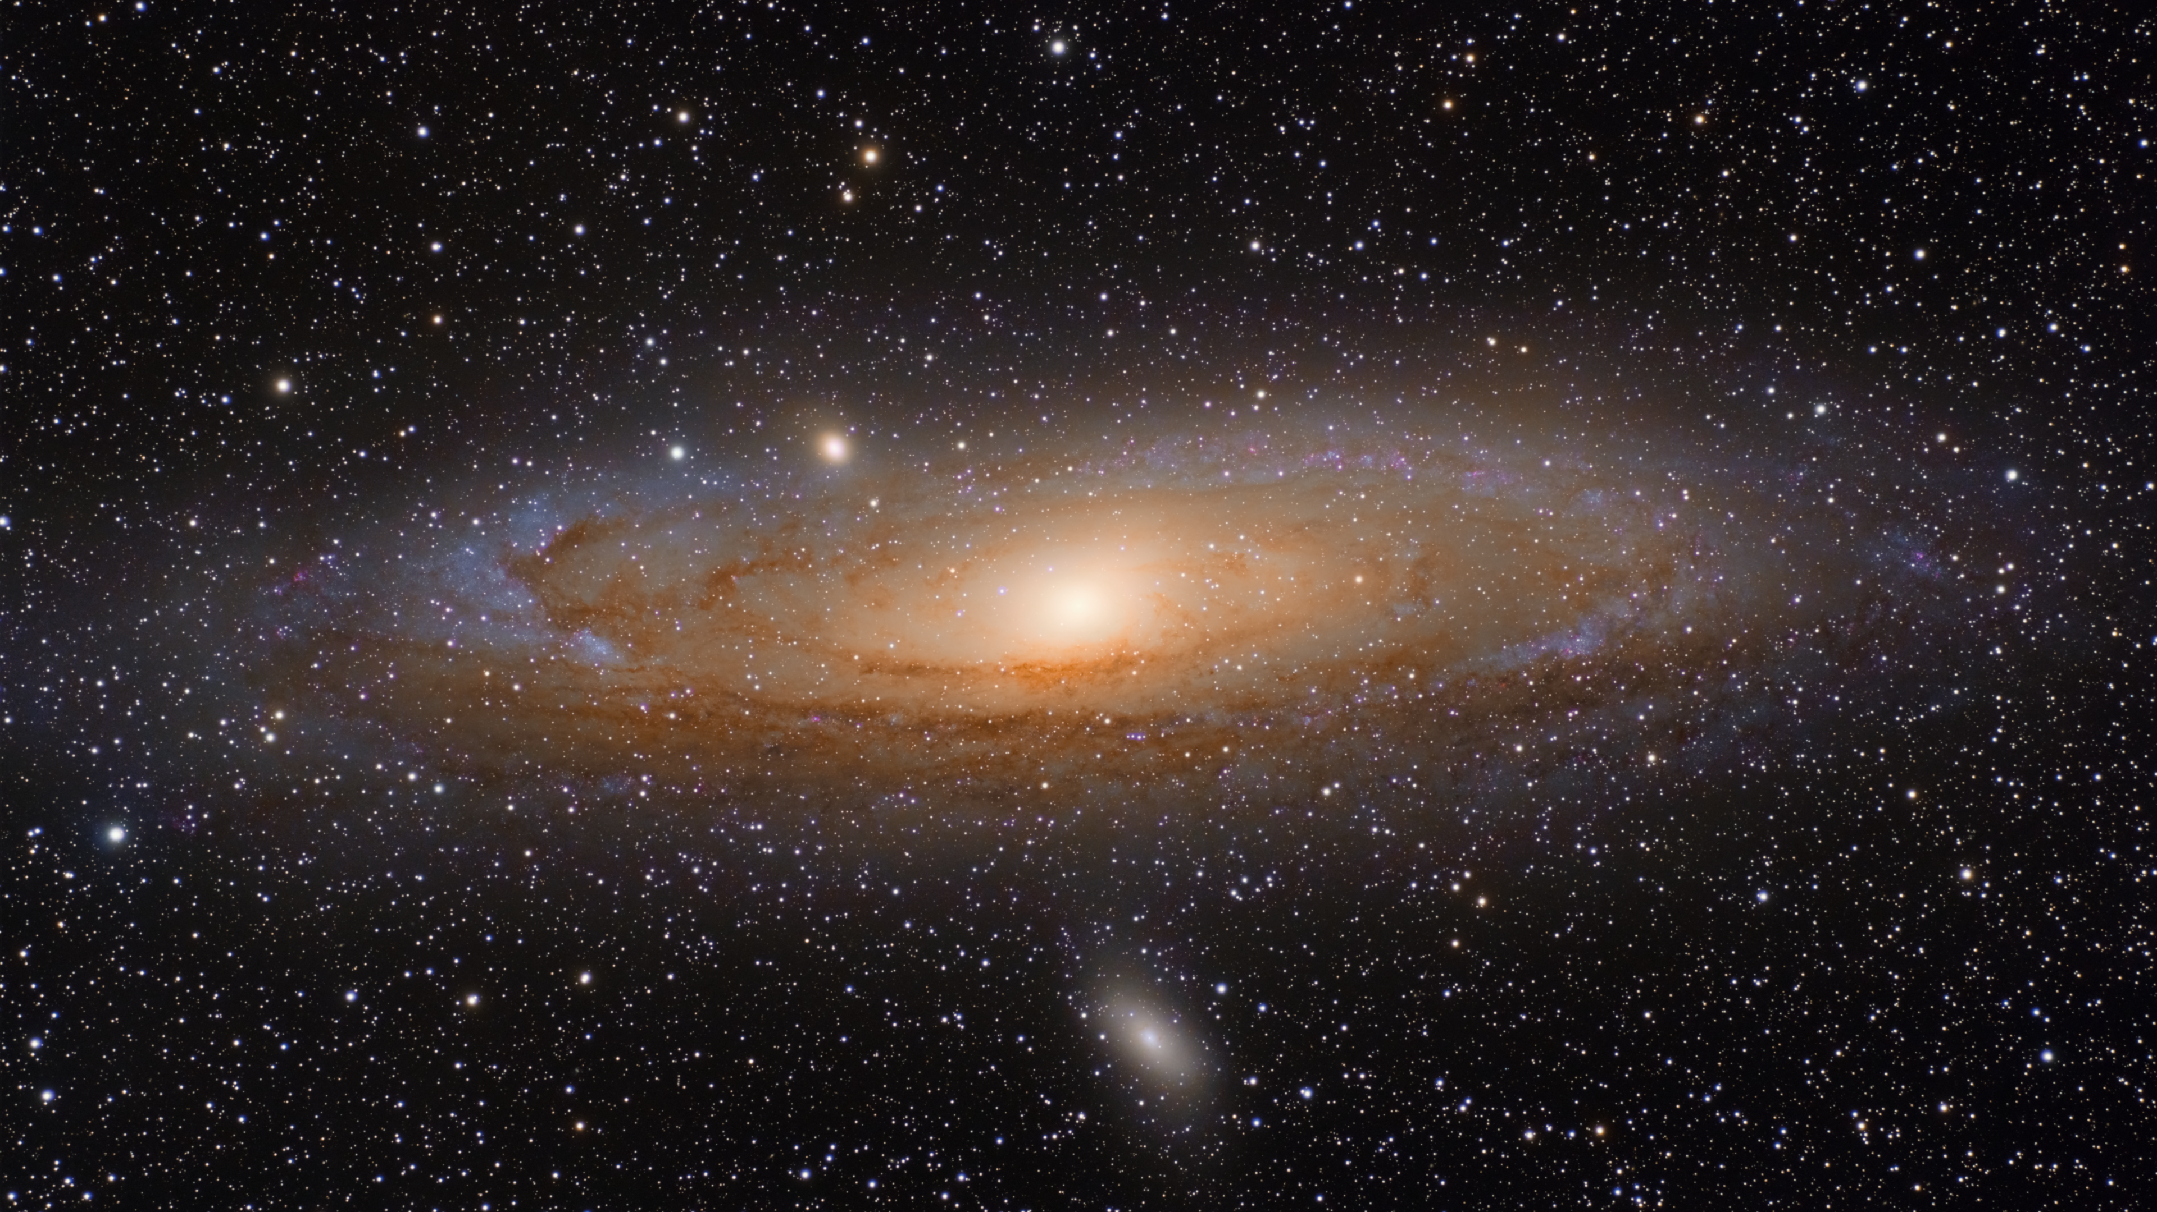

Slide 6
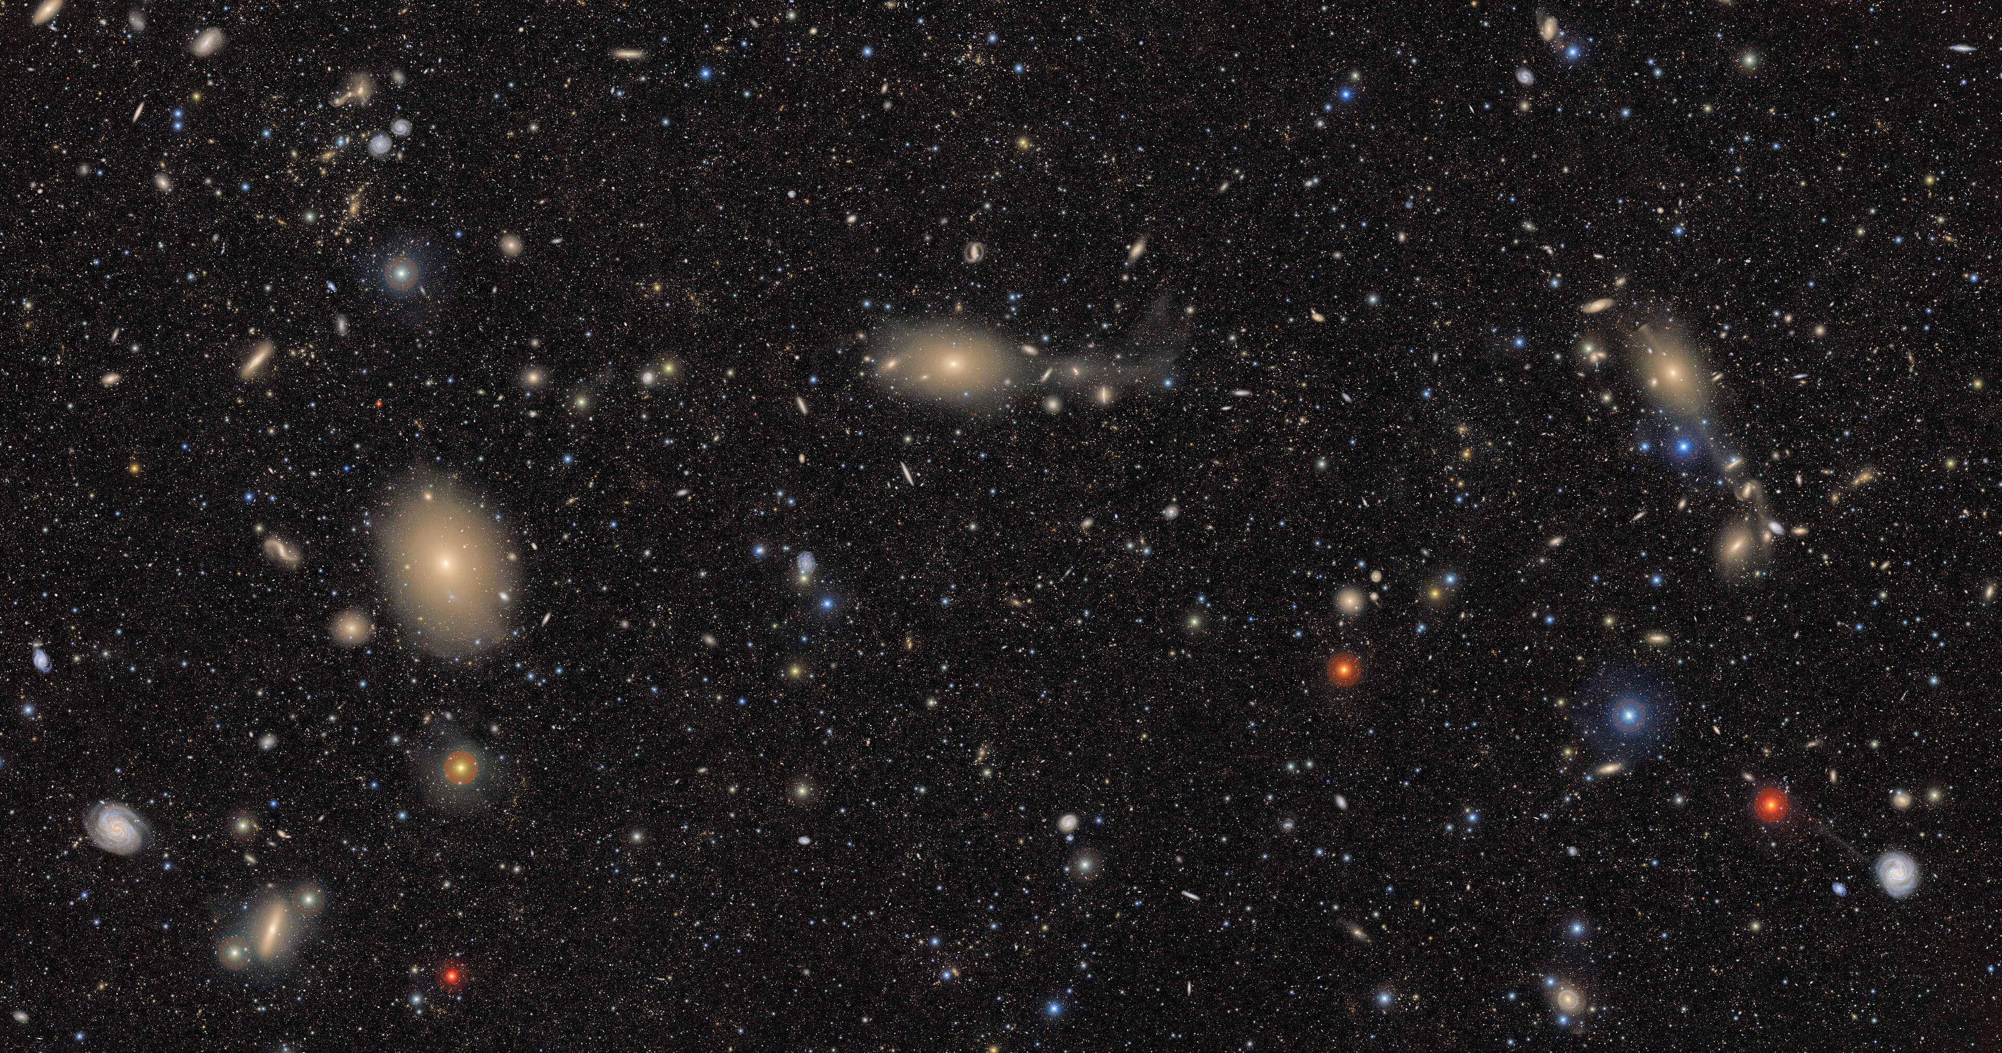

Slide 7
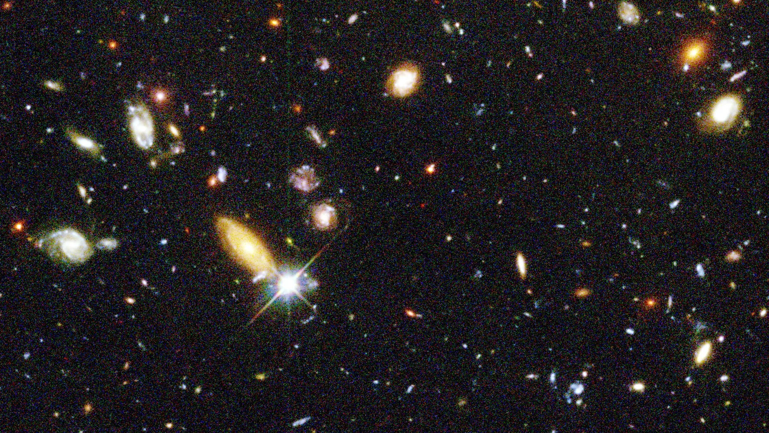

Slide 8
The History Of The Universe
The Big Bang
Inflation
Current Expansion
Ultimate Fate

Slide 9
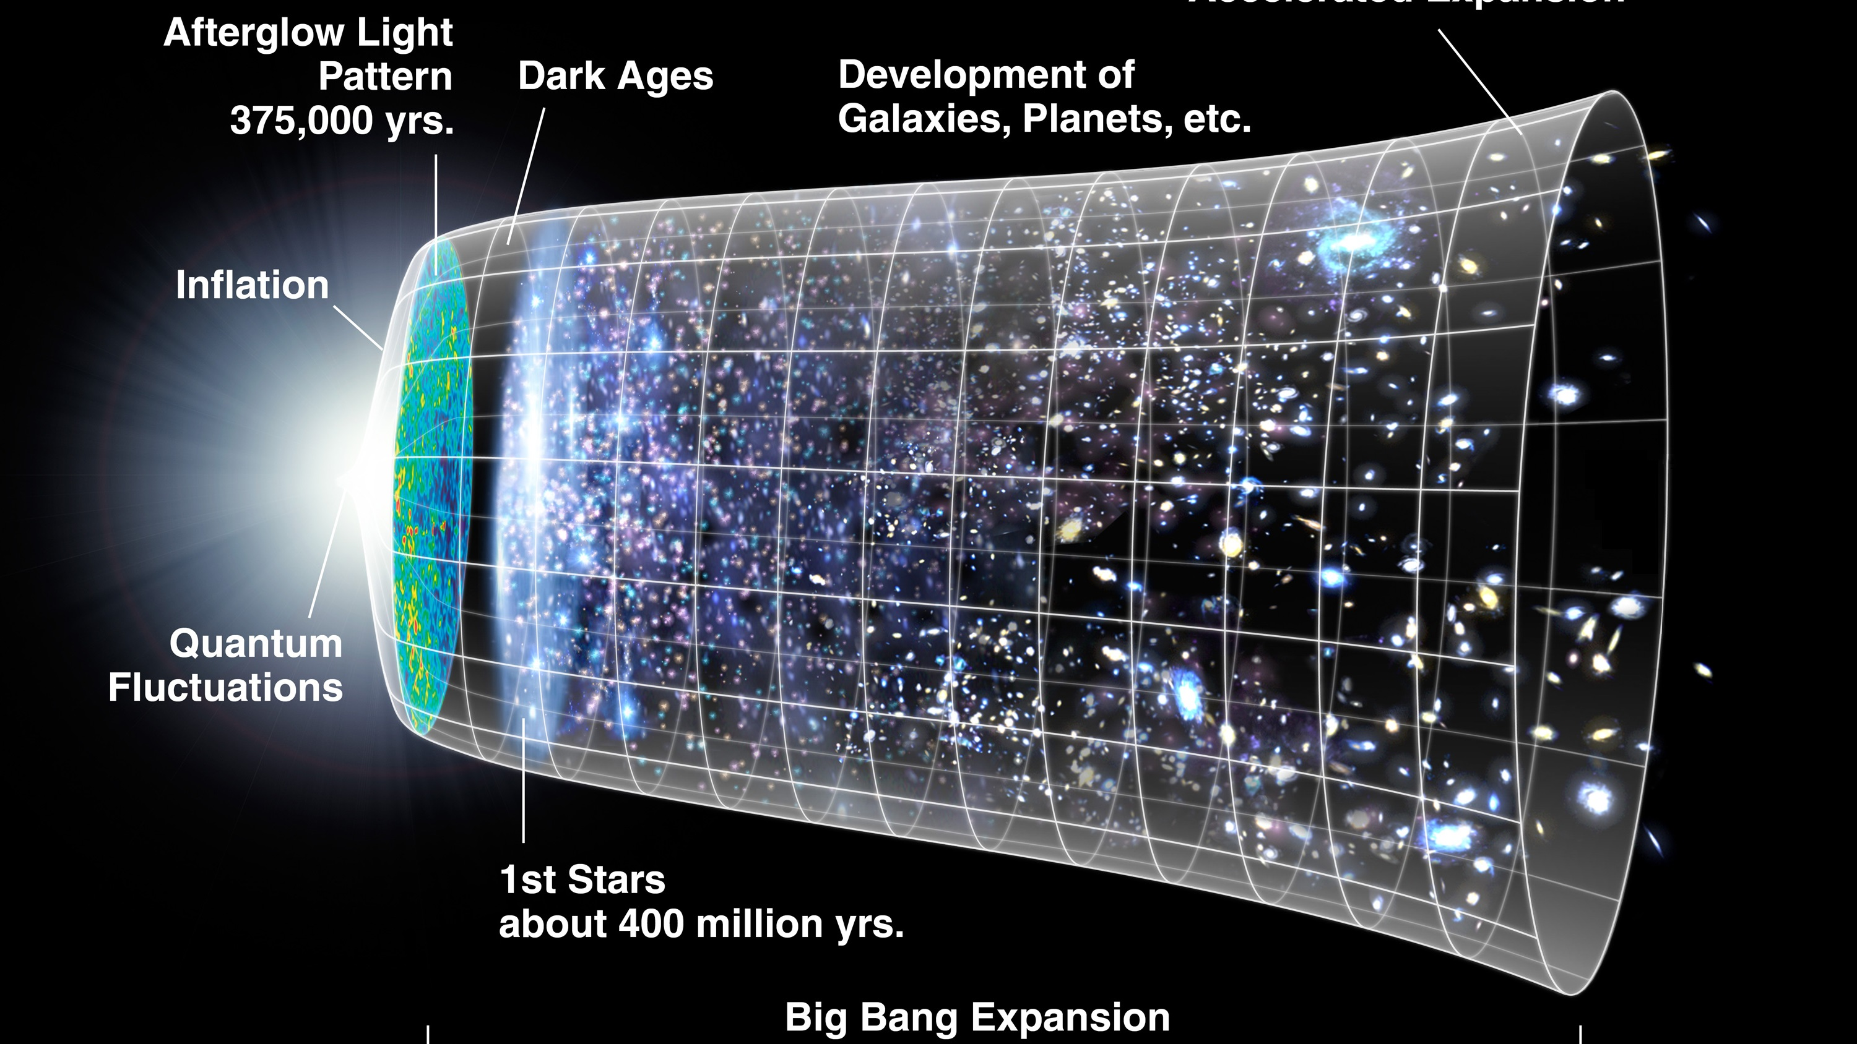

Slide 10
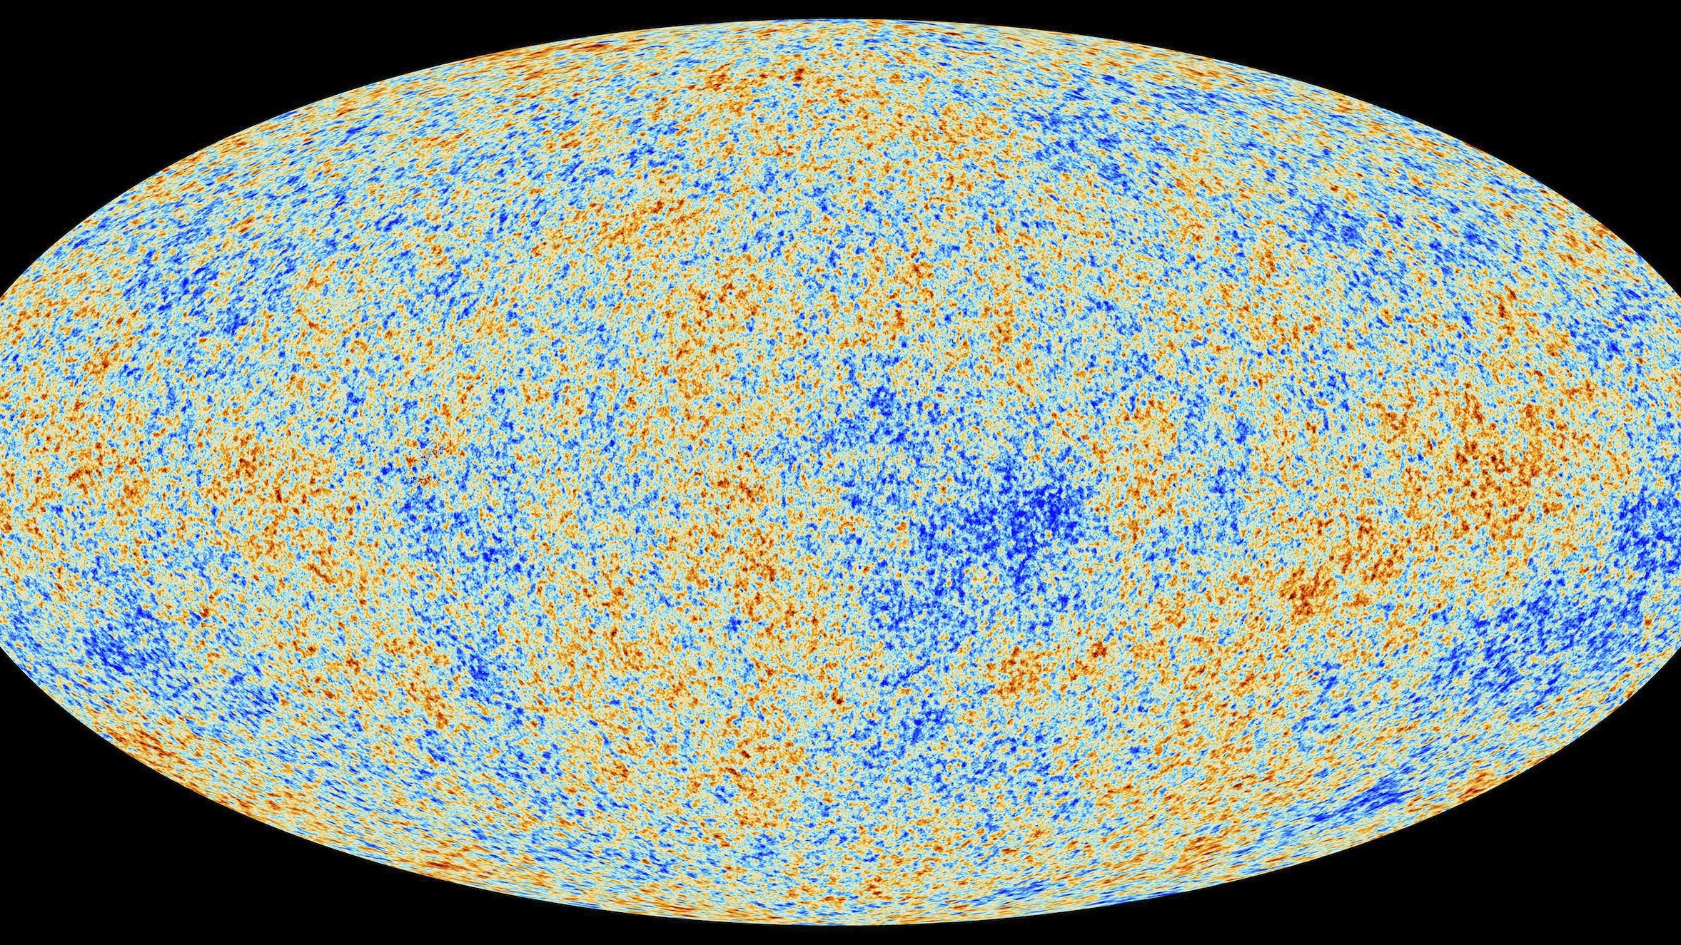

Slide 11
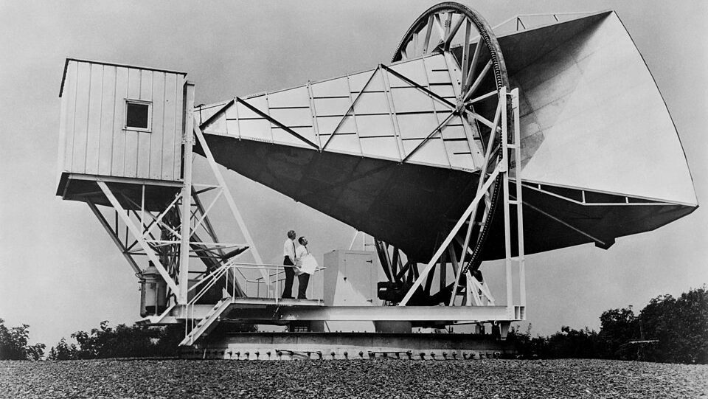

Slide 12
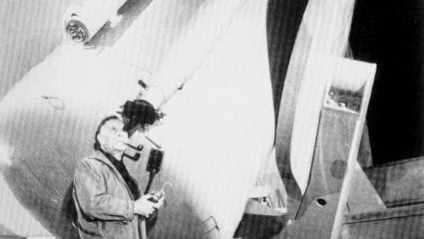

Slide 13
Where Are We?
On a small rocky planet
In a solar system orbiting a small star
In a spiral arm of a galaxy

Slide 14
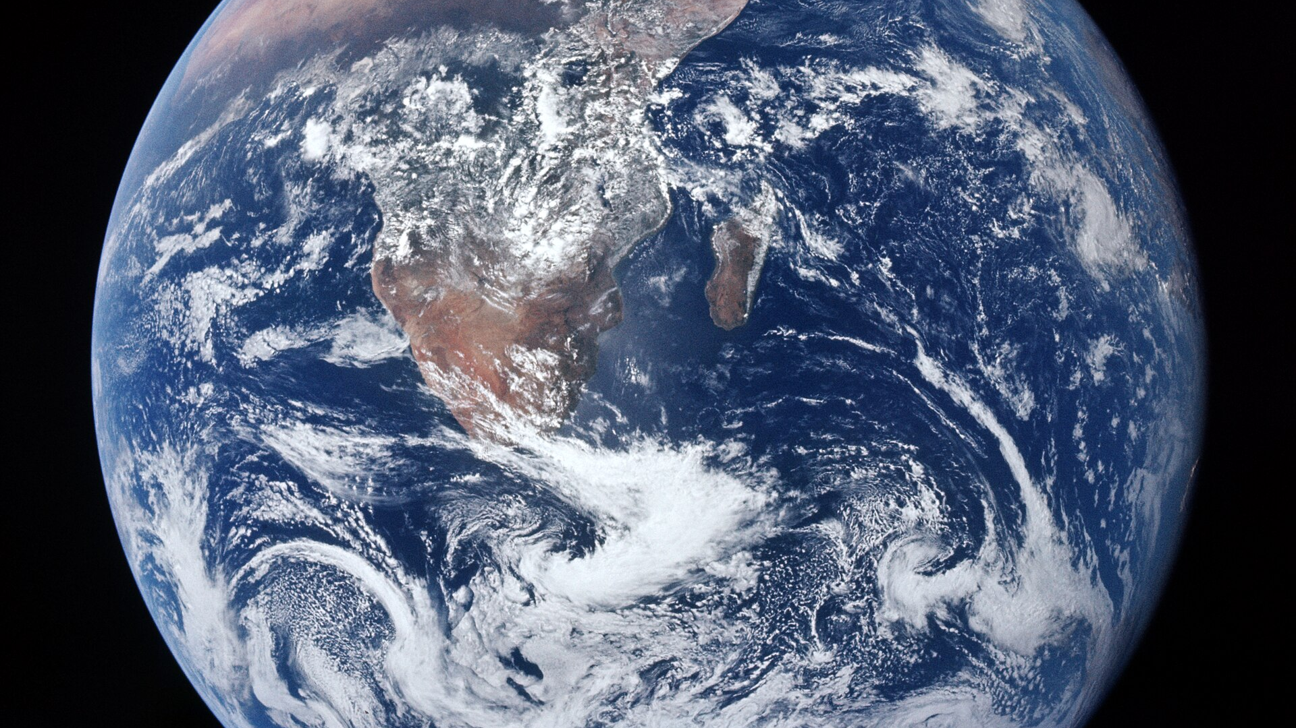

Slide 15
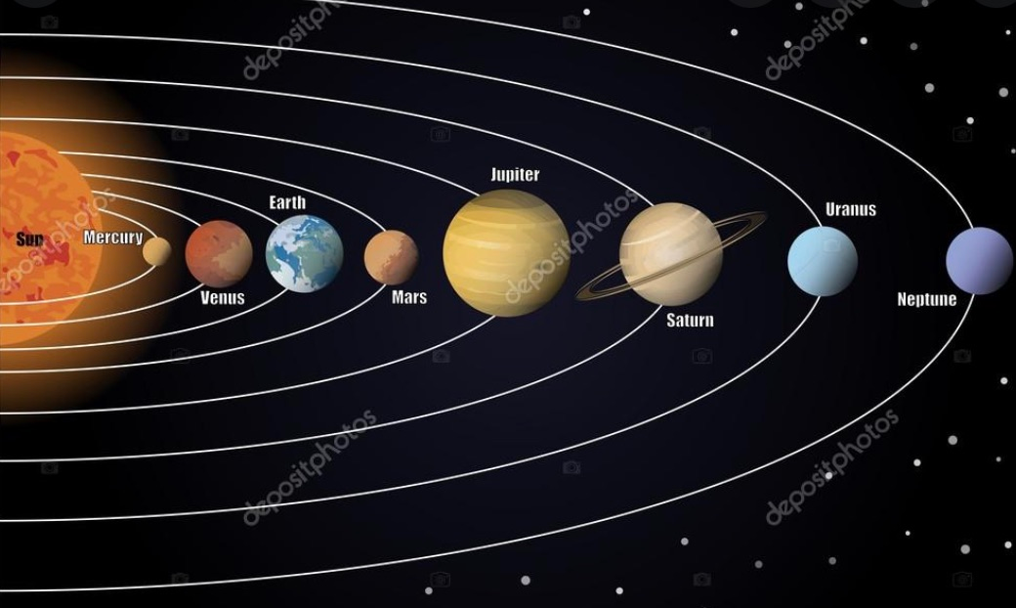

Slide 16
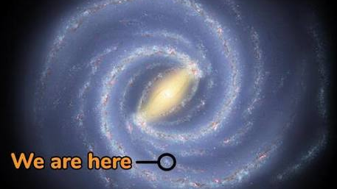

Slide 17
How Can You Study The Universe
Read: Books and Internet
Observe: By eye or with an instrument

Slide 18
What Can You See By Eye
Sun, Moon, Bright Planets
Stars and Constellations
Meteors and Comets
Aurora
Milky Way
Andromeda Galaxy

Slide 19
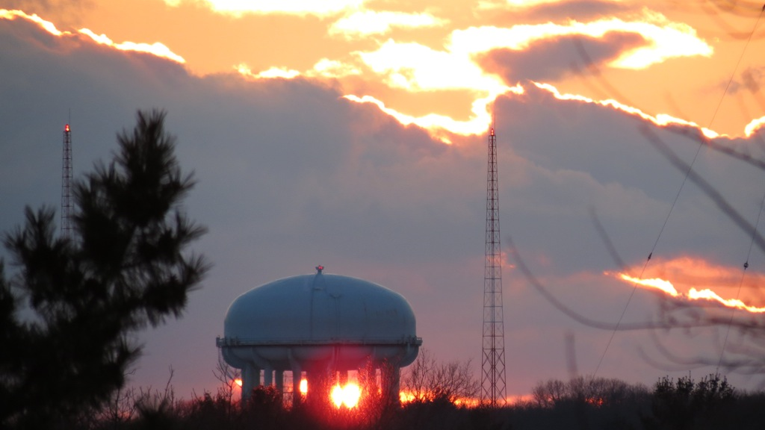

Slide 20
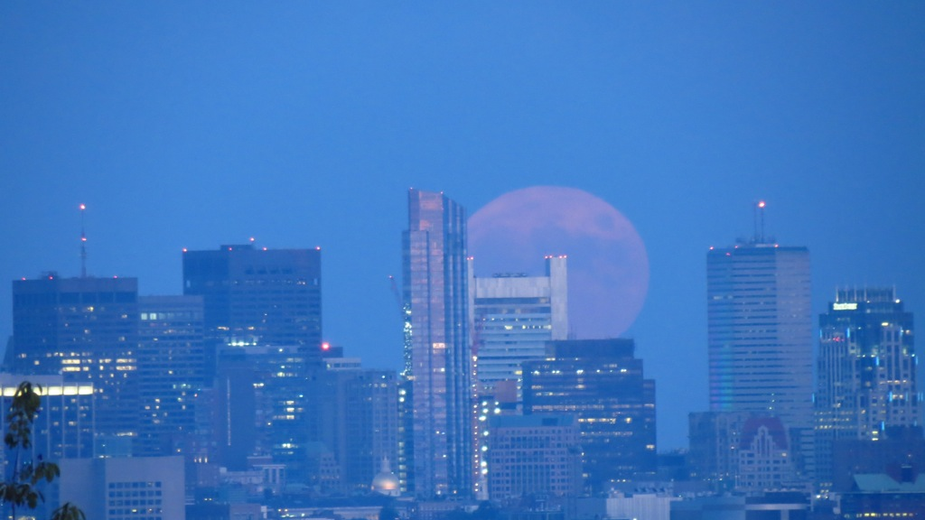

Slide 21
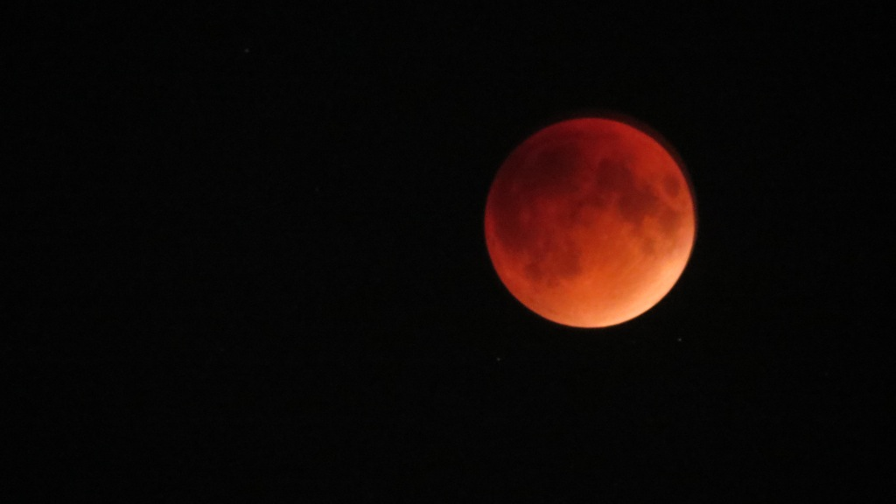

Slide 22
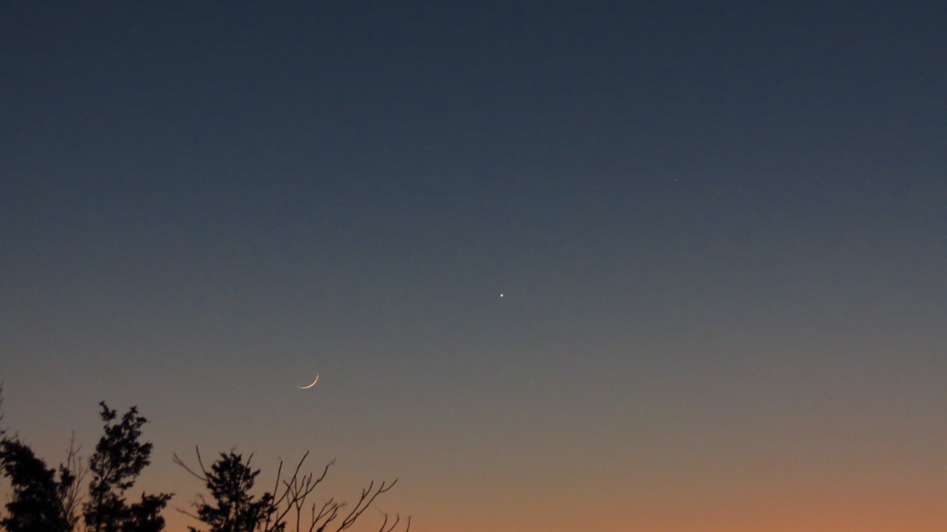

Slide 23
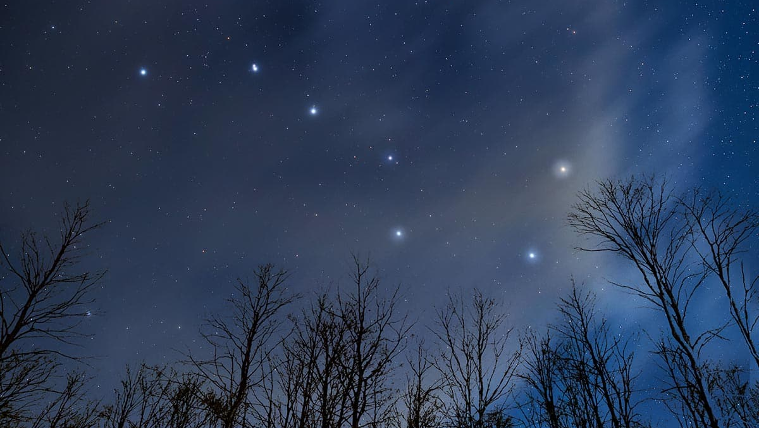

Slide 24
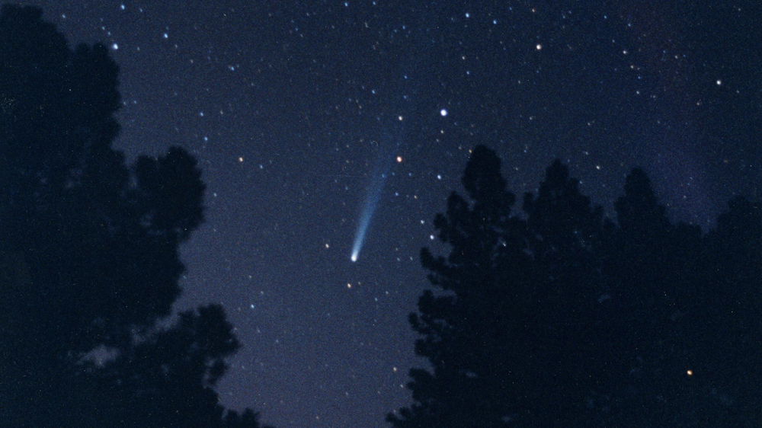

Slide 25
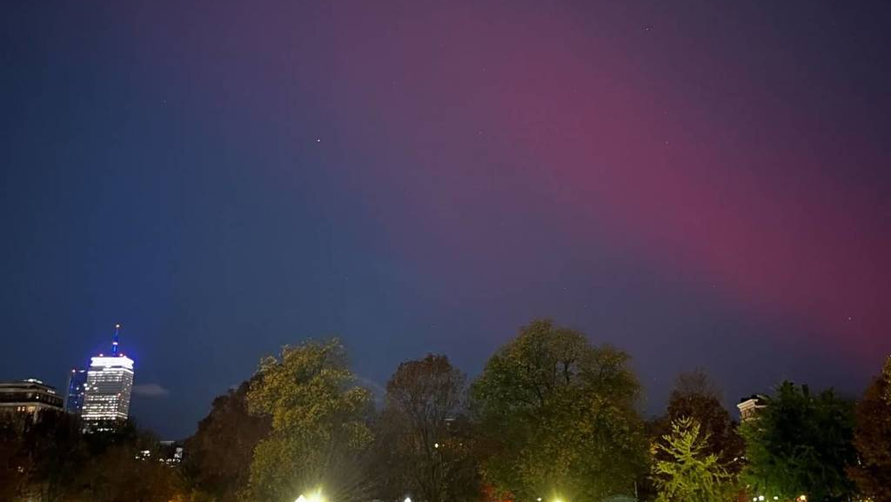

Slide 26
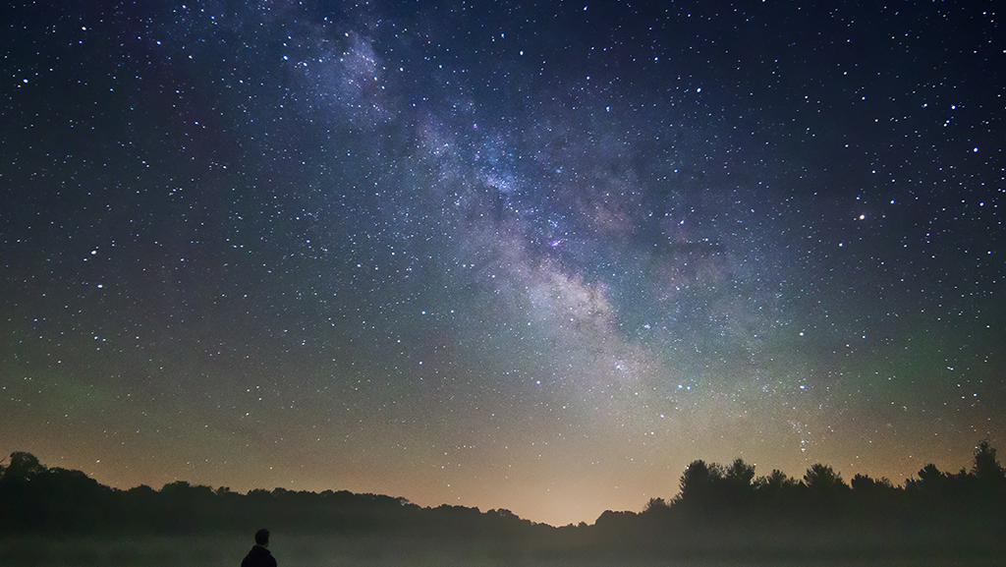

Slide 27
What Affects Where Things Are In The Sky
Ecliptic
Earth Axis Tilt
Latitude and Longitude
Sky Coordinates
Celestial Equator
The Seasons

Slide 28


Slide 29
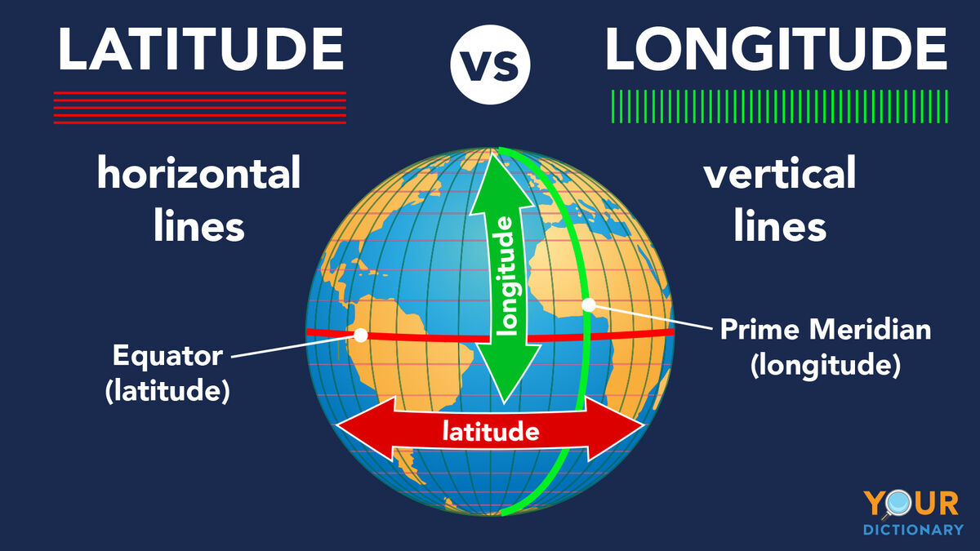

Slide 30
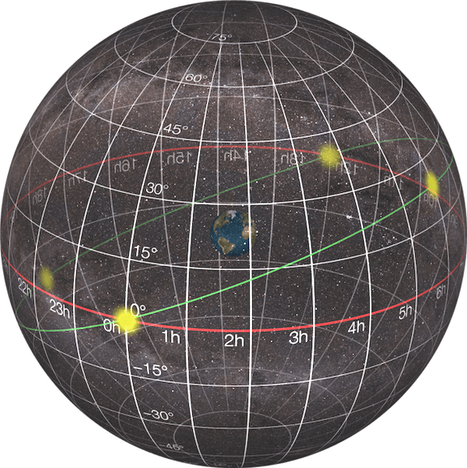

Slide 31
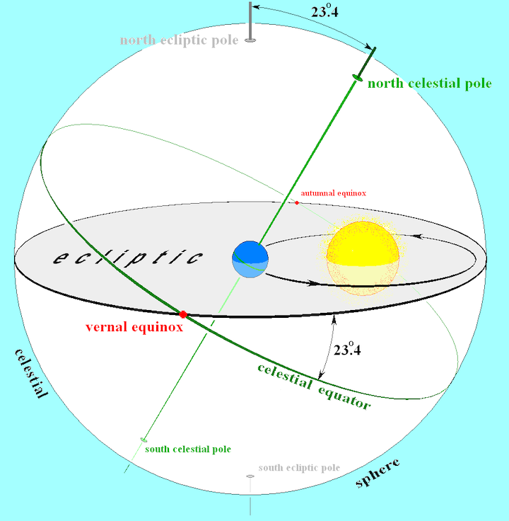

Slide 32
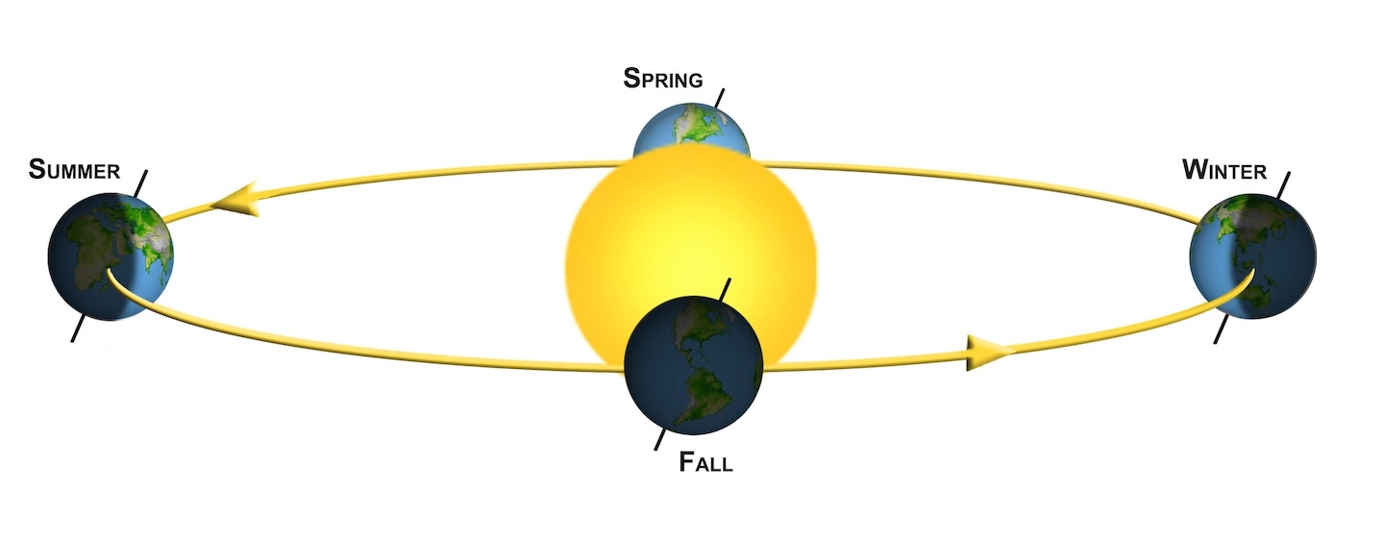

Slide 33
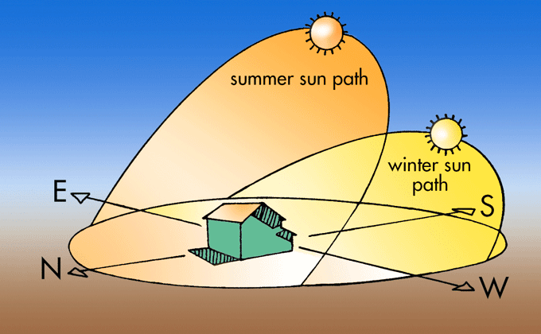

Slide 34
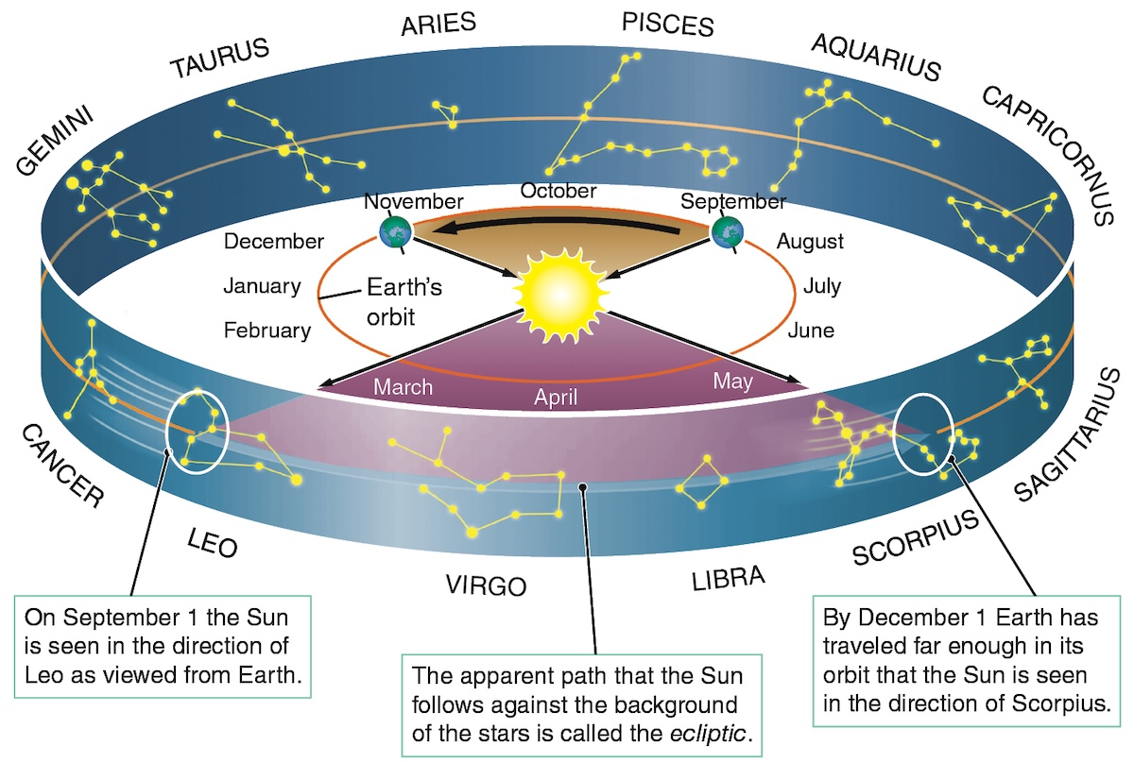

Slide 35
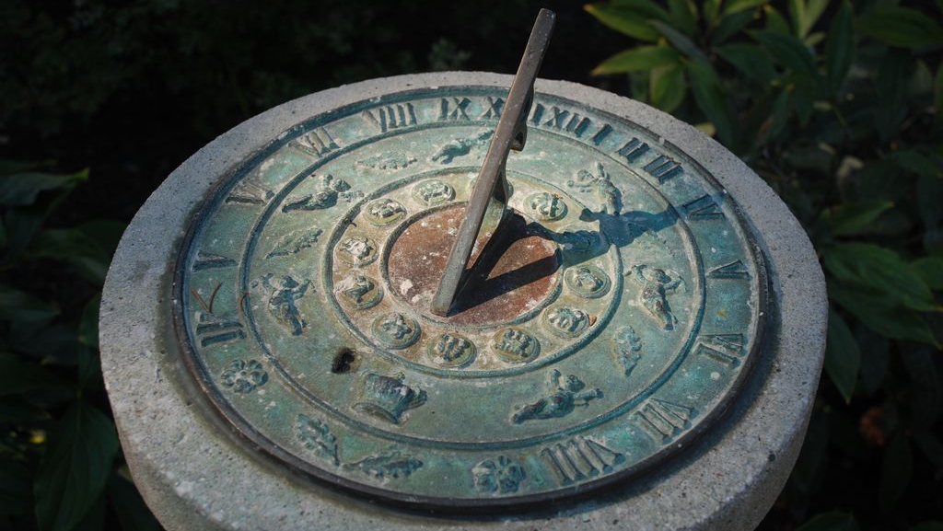

Slide 36
